Slide 1
Regression and regularization
Lecture 1d

Slide 2
Overview
Linear regression
Ridge Regression
Lasso
Variable selection

Slide 3
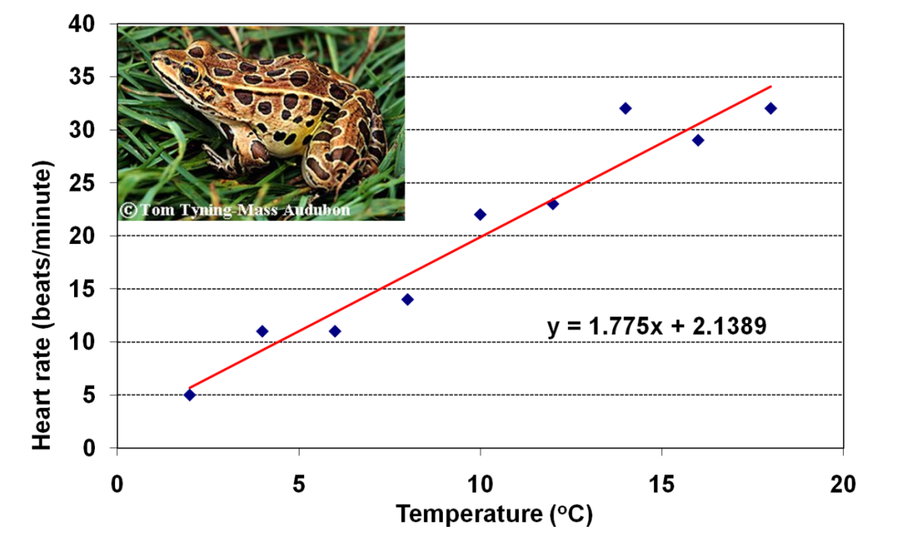
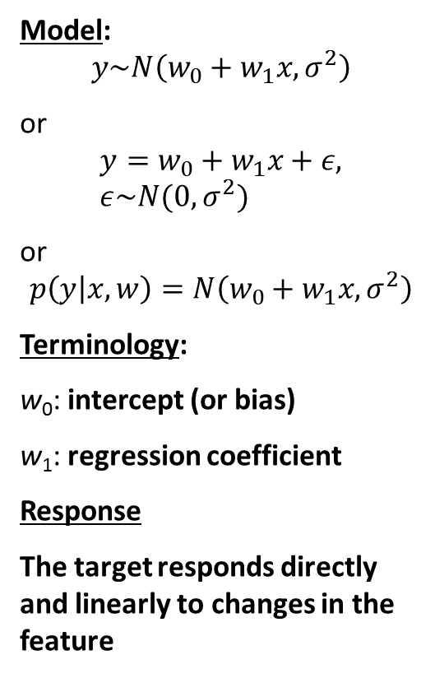
Simple linear regression
Model:
$$y\sim N\left(w_{0}+w_{1}x, σ^{2}\right)$$
or
$$y=w_{0}+w_{1}x+ε, ε\sim N(0, σ^{2})$$
or
$$p\left(y | x,w\right)=N\left(w_{0}+w_{1}x, σ^{2}\right)$$
Terminology:
w₀: intercept (or bias)
w₁: regression coefficient
Response
The target responds directly and linearly to changes in the feature

Slide 4
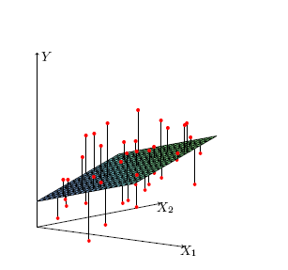
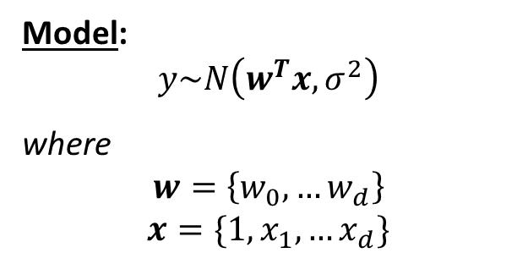
Ordinary least squares regression (OLS)
Model:
$$y\sim N\left(w^{T}x, σ^{2}\right)$$
where
$$w=\left\{w_{0},…w_{d}\right\}$$
$$x=\{1,x_{1},…x_{d}\}$$
The response variable responds directly and linearly to changes in each of the inputs
Why is ”1” here?

Slide 5

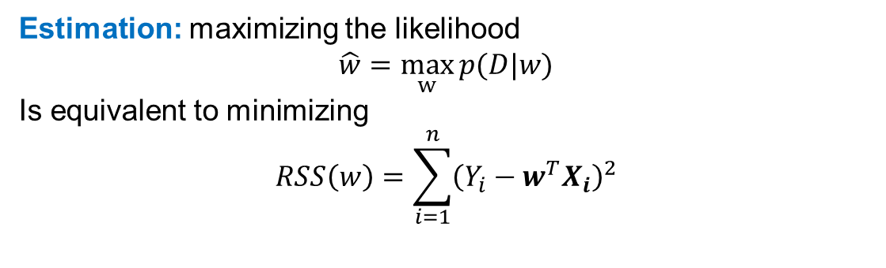
Ordinary least squares regression
Given data set $D$
Estimation: maximizing the likelihood
$$\hat{w}=\max_{w}{p(D|w)}$$
Is equivalent to minimizing
$$RSS\left(w\right)=\sum_{i=1}^{n}{{\left(Y_{i}−w^{T}X_{i}\right)}^{2}}$$

Slide 6
Matrix formulation of OLS regression
Optimality condition:
where
and

Slide 7

Parameter estimates and predictions
Least squares estimates of the parameters
Predicted values
Linear regression belongs to the class of linear smoothers
Hat matrix
Why is it called so?

Slide 8
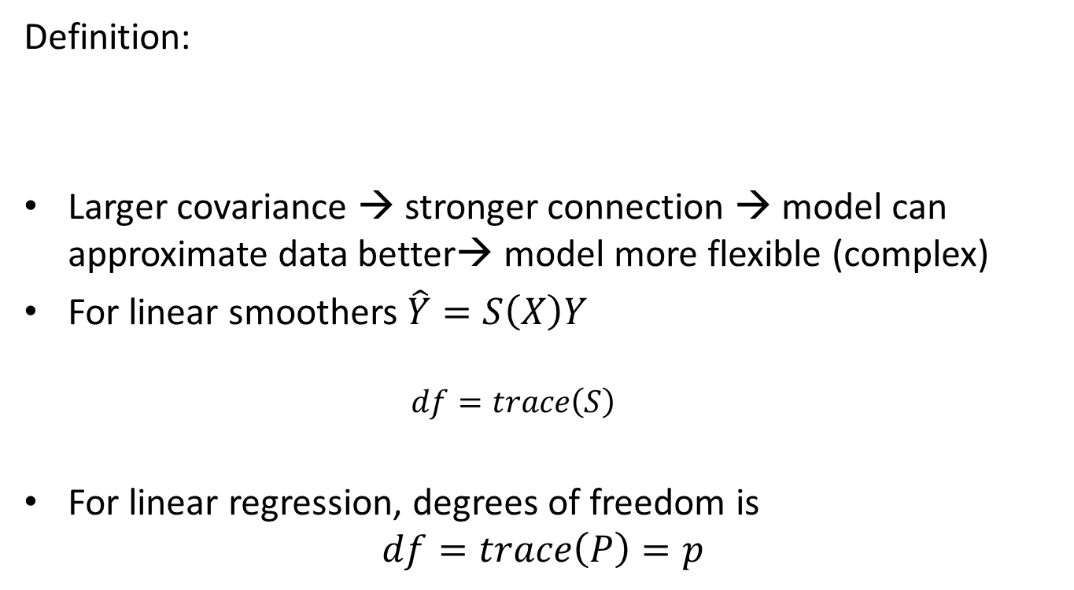
Degrees of freedom
Definition:
Larger covariance → stronger connection → model can approximate data better→ model more flexible (complex)
For linear smoothers $\hat{Y}=S\left(X\right)Y$
$$df=trace\left(S\right)$$
For linear regression, degrees of freedom is
$$df=trace\left(P\right)=p$$

Slide 9
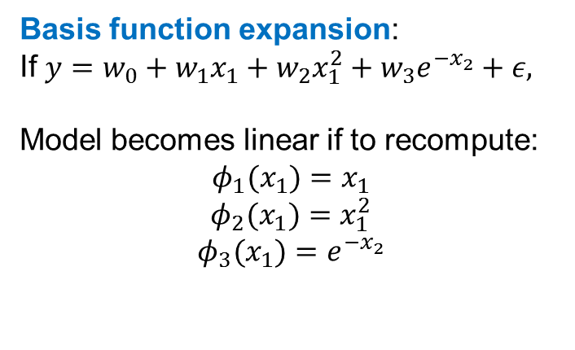
Different types of features
Interval variables
Numerically coded ordinal variables
(small=1, medium=2, large=3)
Dummy coded qualitative variables
Example of dummy coding:
Basis function expansion:
If $y=w_{0}+w_{1}x_{1}+w_{2}x_{1}^{2}+w_{3}e^{−x_{2}}+ε,$
Model becomes linear if to recompute:
$$φ_{1}(x_{1})=x_{1}$$
$$φ_{2}(x_{1})=x_{1}^{2}$$
$$φ_{3}(x_{1})=e^{−x_{2}}$$

Slide 10
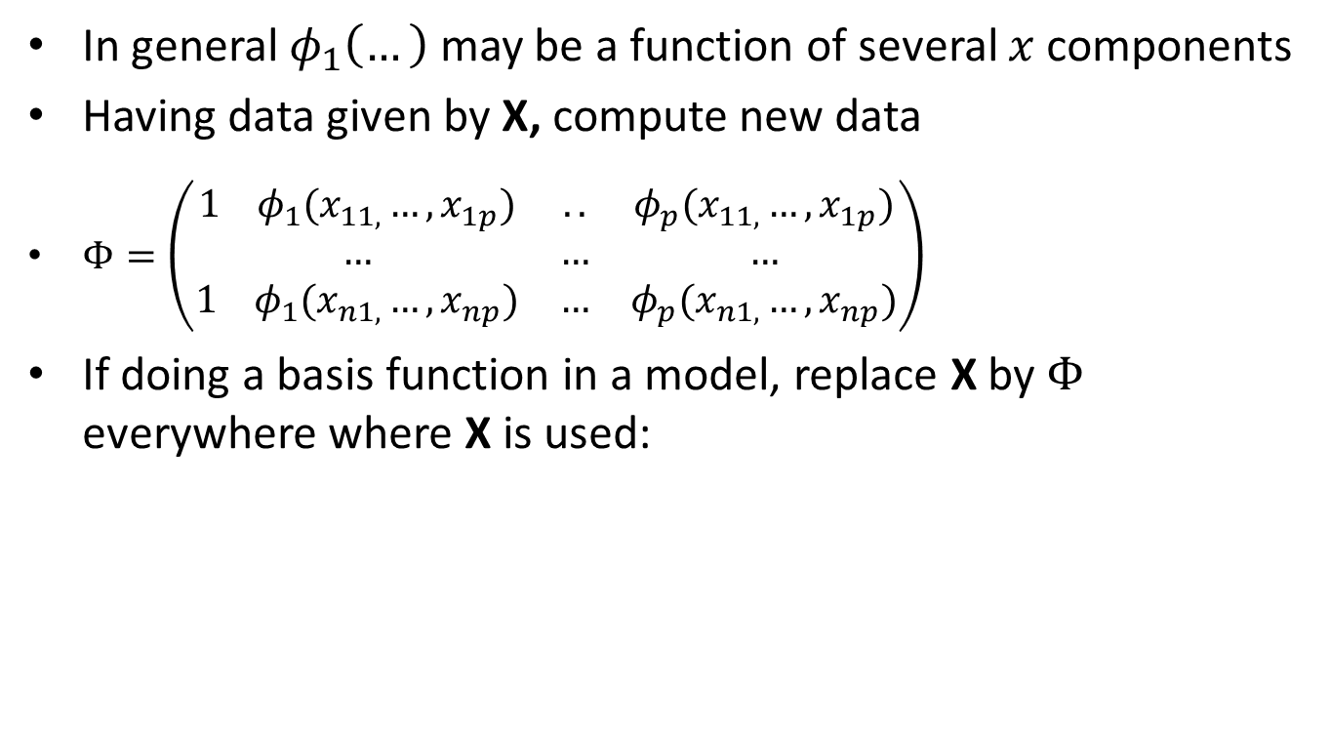
Basis function expansion
In general $φ_{1}\left(…\right)$ may be a function of several $x$ components
Having data given by X, compute new data
$Φ=\left(\begin{matrix}1 { φ}_{1}(x_{11,}…, x_{1p}) & .. & φ_{p}(x_{11,}…, x_{1p}) \\ … & … & … \\ 1 φ_{1}(x_{n1,}…, x_{np}) & … & φ_{p}(x_{n1,}…, x_{np})\end{matrix}\right)$
If doing a basis function in a model, replace X by $Φ$ everywhere where X is used:

Slide 11
Linear regression in R
fit=lm(formula, data, subset, weights,…)
data is the data frame containing the predictors and response values
formula is expression for the model
subset which observations to use (training data)?
weights should weights be used?
fit is object of class lm containing various regression results.
Useful functions (many are generic, used in many other models)
Get details about the particular function by ”.”, for ex. predict.lm
summary(fit)
predict(fit, newdata, se.fit, interval)
coefficients(fit) # model coefficients confint(fit, level=0.95) # CIs for model parameters fitted(fit) # predicted values residuals(fit) # residuals

Slide 12
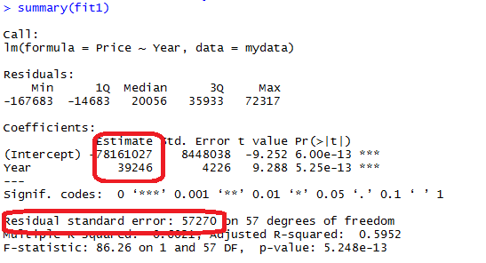
An example of ordinary least squares regression
mydata=read.csv2("Bilexempel.csv")
fit1=lm(Price~Year, data=mydata)
summary(fit1)
fit2=lm(Price~Year+Mileage+Equipment, data=mydata)
summary(fit2)
Response variable:
Requested price of used Porsche cars (1000 SEK)
Inputs:
X₁ = Manufacturing year
X₂ = Milage (km)
X₄ = Equipment (0 or 1)

Slide 13
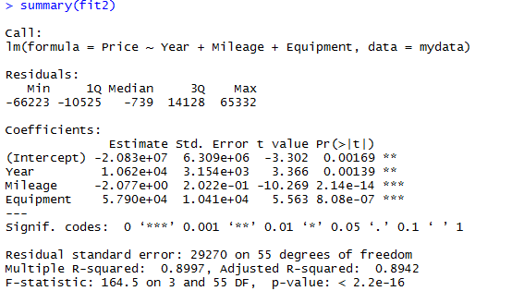
An example of ordinary least squares regression

Slide 14
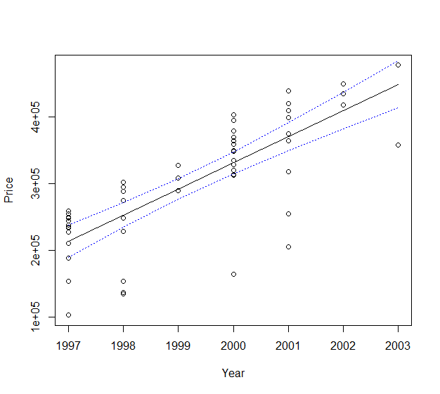
An example of ordinary least squares regression
Prediction
fitted <- predict(fit1, interval = "confidence")
# plot the data and the fitted line
attach(mydata)
plot(Year, Price)
lines(Year, fitted[, "fit"])
# plot the confidence bands
lines(Year, fitted[, "lwr"], lty = "dotted", col="blue")
lines(Year, fitted[, "upr"], lty = "dotted", col="blue")
detach(mydata)

Slide 15
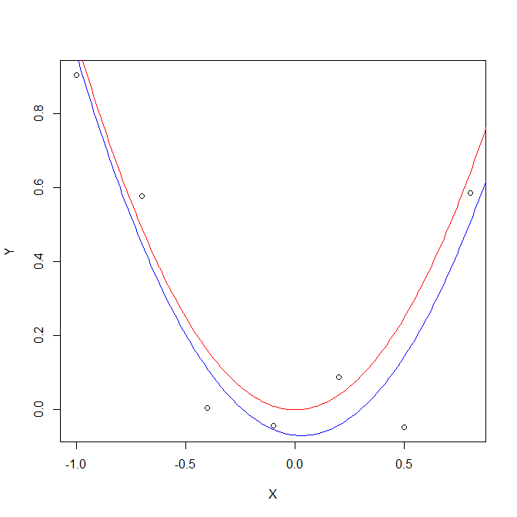
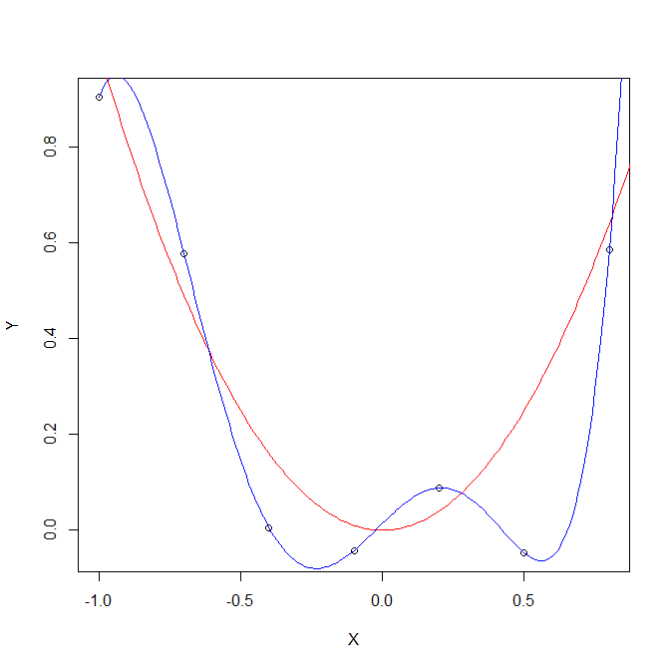

Ridge regression
Problem: linear regression can overfit:
Take $Y≔Y, X_{1}=X, X_{2}=X^{2},…, X_{p}=X^{p}$→ polinomial model, fit by linear regression
High degree of polynomial leads to overfitting.
A
B

Slide 16
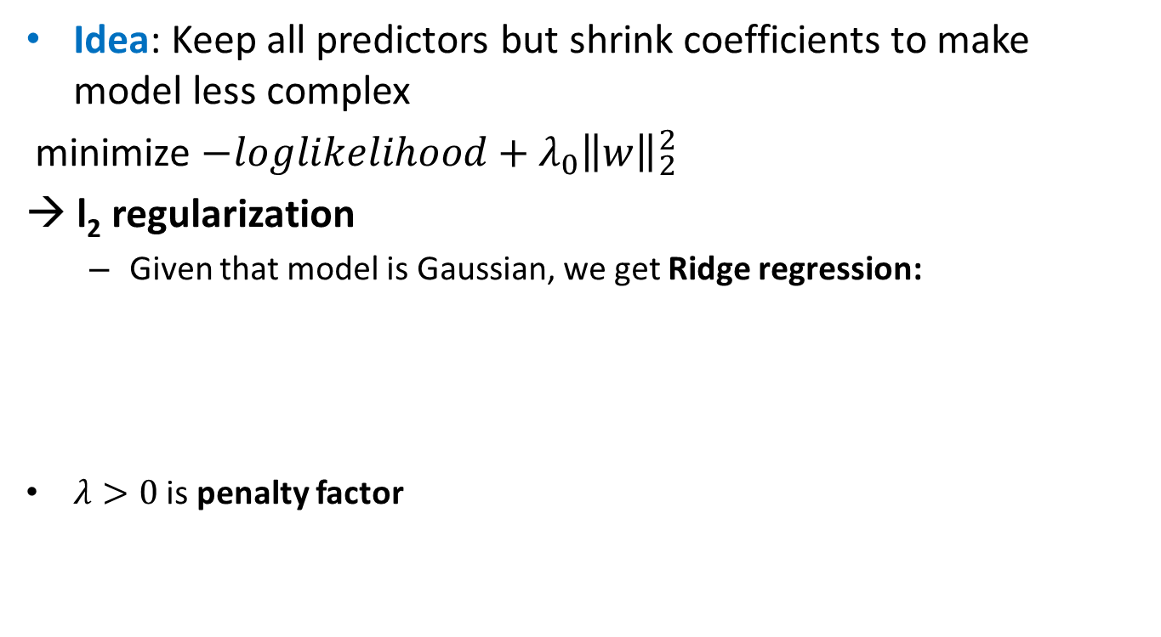
Ridge regression
Idea: Keep all predictors but shrink coefficients to make model less complex
minimize $−loglikelihood+λ_{0}{\left\|w\right\|}_{2}^{2}$
→ l₂ regularization
Given that model is Gaussian, we get Ridge regression:
$λ>0$ is penalty factor

Slide 17

Ridge regression
Equivalent form
Solution
$${\hat{w}}^{ridge}={\left(X^{T}X+λI\right)}^{−1}X^{T}y$$
How do we compute degrees of freedom here?
Hat matrix

Slide 18
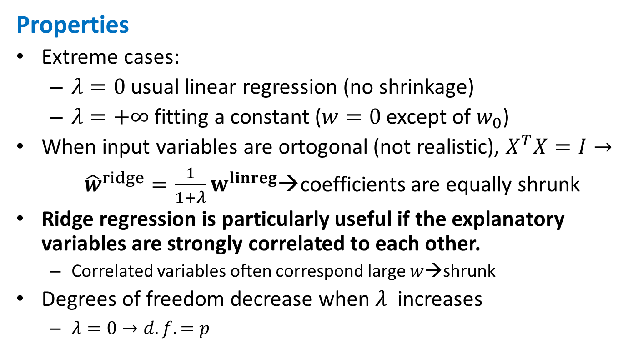
Ridge regression
Properties
Extreme cases:
$λ=0$ usual linear regression (no shrinkage)
$λ=+∞$ fitting a constant ($w=0$ except of $w_{0}$)
When input variables are ortogonal (not realistic), $X^{T}X=I→$
${\hat{w}}^{ridge}=\frac{1}{1+λ}w^{linreg}$→coefficients are equally shrunk
Ridge regression is particularly useful if the explanatory variables are strongly correlated to each other.
Correlated variables often correspond large $w$→shrunk
Degrees of freedom decrease when $λ$ increases
$λ=0→d.f.=p$

Slide 19
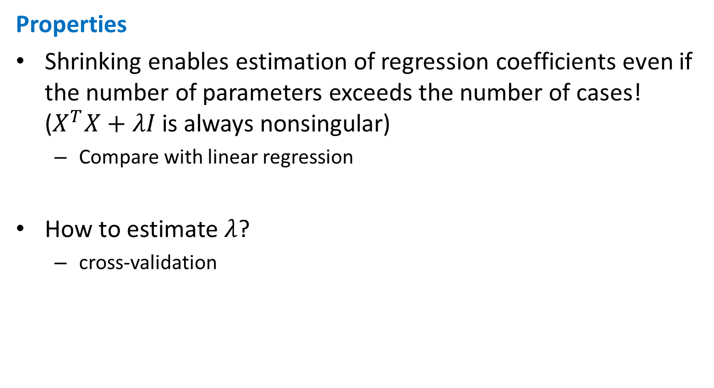
Ridge regression
Properties
Shrinking enables estimation of regression coefficients even if the number of parameters exceeds the number of cases! ($X^{T}X+λI$ is always nonsingular)
Compare with linear regression
How to estimate $λ$?
cross-validation

Slide 20
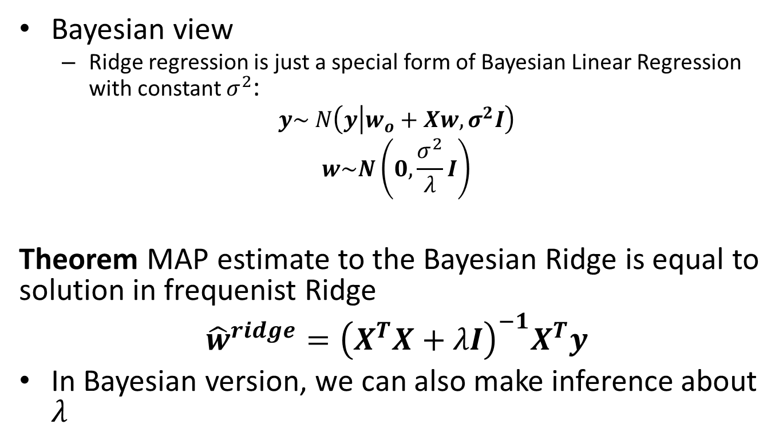
Ridge regression
Bayesian view
Ridge regression is just a special form of Bayesian Linear Regression with constant $σ^{2}$:
$$y\sim N\left(y | w_{o}+Xw,σ^{2}I\right)$$
$$w\sim N\left(0,\frac{σ^{2}}{λ}I\right)$$
Theorem MAP estimate to the Bayesian Ridge is equal to solution in frequenist Ridge
$${\hat{w}}^{ridge}={\left(X^{T}X+λI\right)}^{−1}X^{T}y$$
In Bayesian version, we can also make inference about $λ$

Slide 21

Ridge regression
Example Computer Hardware Data Set : performance measured for various processors and also
Cycle time
Memory
Channels
…
Build model predicting performance

Slide 22
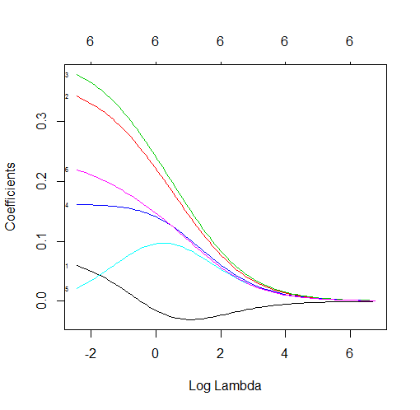
Ridge regression
R code: use package glmnet with alpha=0 (Ridge regression)
Seeing how Ridge converges
data=read.csv("machine.csv", header=F)
covariates=scale(data[,3:8])
response=scale(data[, 9])
model0=glmnet(as.matrix(covariates), response, alpha=0,family="gaussian")
plot(model0, xvar="lambda", label=TRUE)

Slide 23
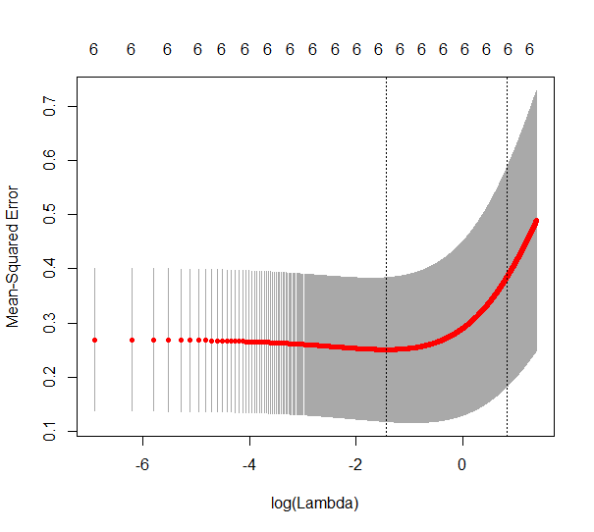
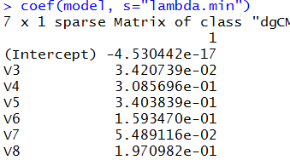
Ridge regression
Choosing the best model by cross-validation:
model=cv.glmnet(as.matrix(covariates), response, alpha=0,family="gaussian")
model$lambda.min
plot(model)
coef(model, s="lambda.min")
> model$lambda.min
[1] 0.046

Slide 24

Ridge regression
How good is this model in prediction?
ind=sample(209, floor(209*0.5))
data1=scale(data[,3:9])
train=data1[ind,]
test=data1[-ind,]
covariates=train[,1:6]
response=train[, 7]
model=cv.glmnet(as.matrix(covariates), response, alpha=1,family="gaussian", lambda=seq(0,1,0.001))
y=test[,7]
ynew=predict(model, newx=as.matrix(test[, 1:6]), type="response")
#Coefficient of determination
sum((ynew-mean(y))^2)/sum((y-mean(y))^2)
sum((ynew-y)^2)
Note that data are so small so numbers change much for other train/test

Slide 25
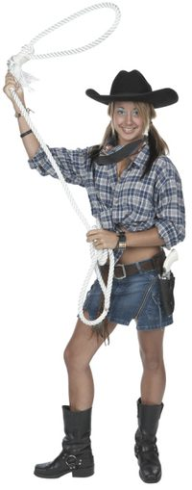
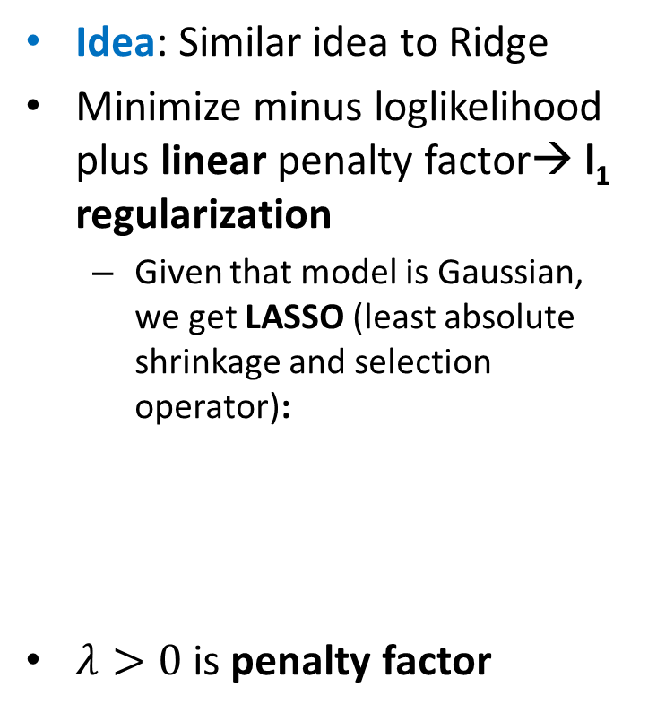
LASSO
Idea: Similar idea to Ridge
Minimize minus loglikelihood plus linear penalty factor→ l₁ regularization
Given that model is Gaussian, we get LASSO (least absolute shrinkage and selection operator):
$λ>0$ is penalty factor
http://img-aws.ehowcdn.com

Slide 26
LASSO
Equivalently

Slide 27
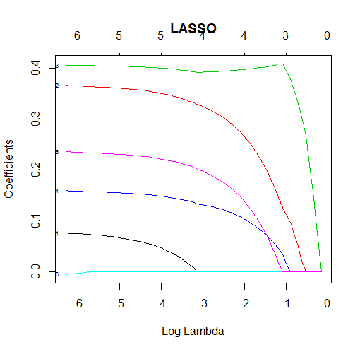
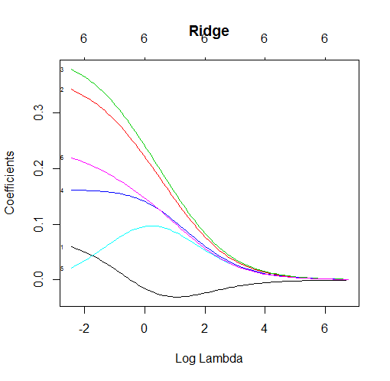
LASSO vs Ridge
LASSO yields sparse solutions!
Example Computer hardware data

Slide 28
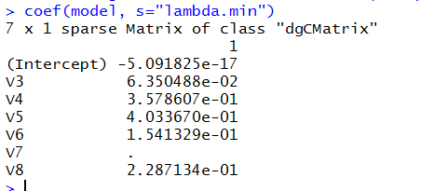

LASSO vs Ridge
Only 5 variables selected by LASSO

Slide 29
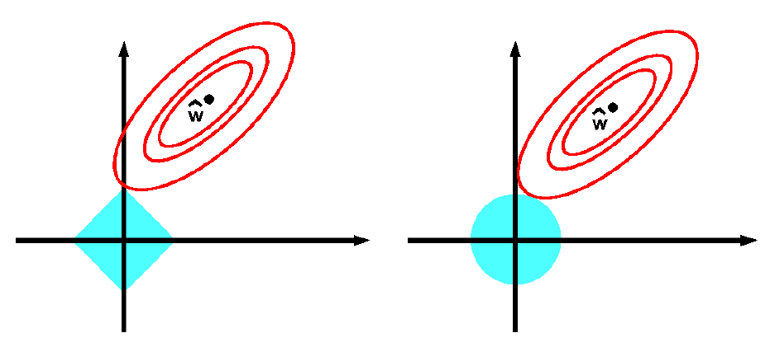
LASSO vs Ridge
Why Lasso leads to sparse solutions?
Feasible area for Ridge is a circle (2D)
Feasible area for LASSO is a polygon (2D)

Slide 30
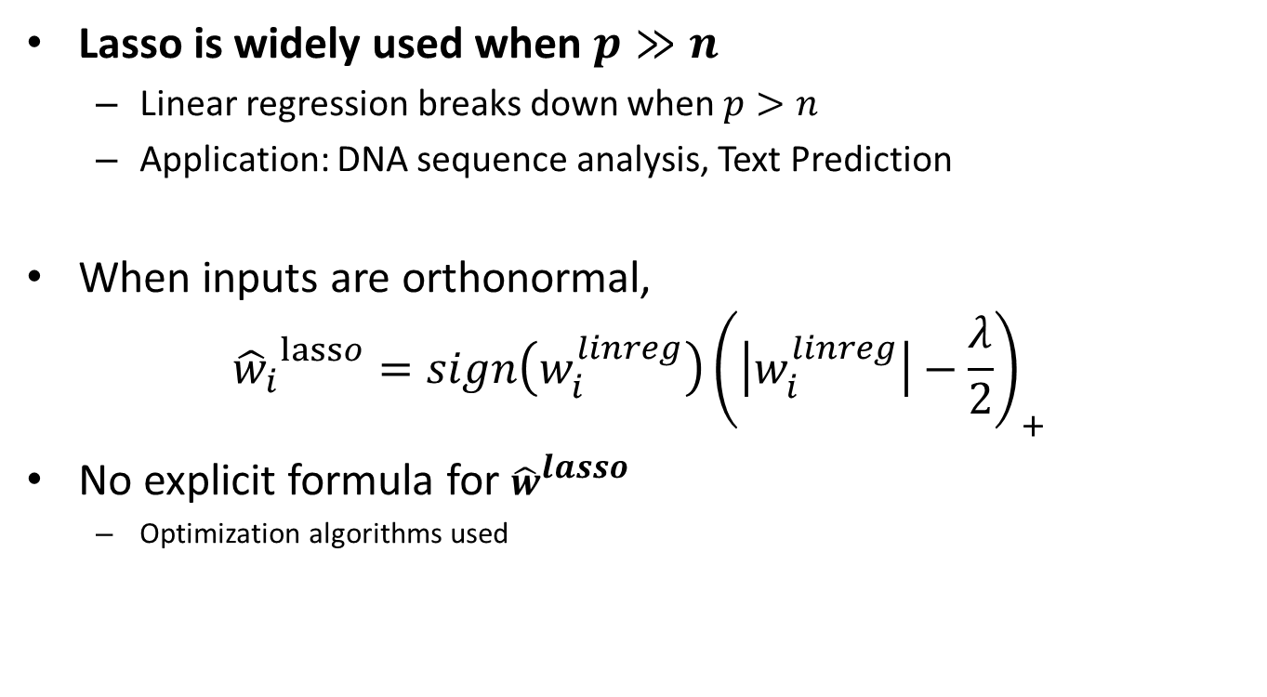
LASSO properies
Lasso is widely used when $p≫n$
Linear regression breaks down when $p>n$
Application: DNA sequence analysis, Text Prediction
When inputs are orthonormal,
$${{\hat{w}}_{i}}^{lasso}=sign\left(w_{i}^{linreg}\right){\left(\left|w_{i}^{linreg}\right|−\frac{λ}{2}\right)}_{+}$$
No explicit formula for ${\hat{w}}^{lasso}$
Optimization algorithms used
Coding in R: use glmnet() with alpha=1

Slide 31
Variable selection
.. Or “Feature selection”
Often, we do not need all features available in the data to be in the model
Reasons:
Model can become overfitted (recall polynomial regression)
Large number of predictors → model is difficult to use and interpret

Slide 32
Variable selection
Alternative 1: Variable subset selection
Best subset selection:
Consider different subsets of the full set of features, fit models and evaluate their quality
Problem: computationally difficult for p around 30 or more
How to choose the best model size? Some measure of predictive performance normally used (ex. AIC).
Forward and Backward stepwise selection
Starts with 0 features (or full set ) and then adds a feature (removes feature) that most improves the measure selected.
Can handle large p quickly
Does not examine all possible subsets (not the “best”)

Slide 33
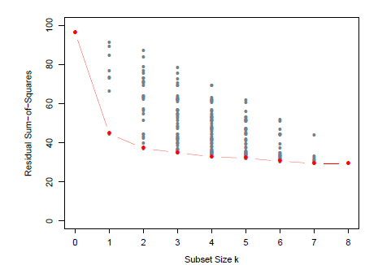
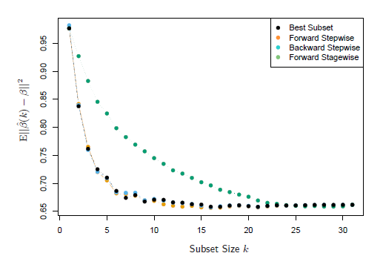
RSS and MSE depend on k

Slide 34
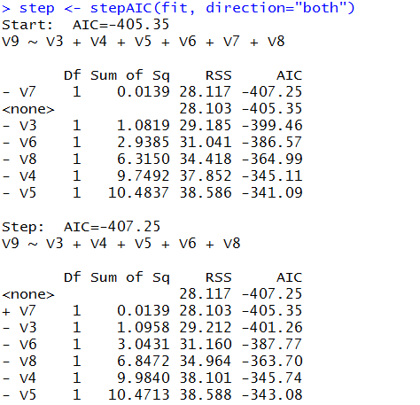
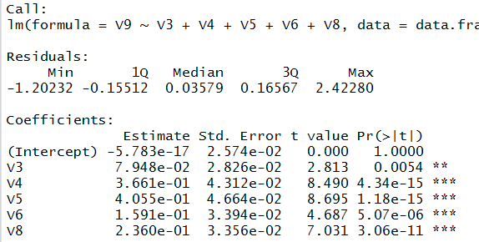
Variable selection in R
Use stepAIC() in MASS
library(MASS)
fit <- lm(V9~.,data=data.frame(data1))
step <- stepAIC(fit, direction="both")
step$anova
summary(step)

